Slide 1


CITS1003 Introduction to Cybersecurity Exam Exercises
Dr Zhi Zhang

Slide 2
Project
The project and its report are due at 11:59 PM on May 19.
https://uwacyber.gitbook.io/cits1003/cits1003-project/overview
https://docs.google.com/document/d/1wlSfCf2KAC-q_y_hm7Ss0brH23rOGXOoydB7ewdm8sU/edit?usp=sharing
Exam

Slide 3
Exam Format
The exam is F2F and has a time limit of 2 hours.
The exam is marked out of 100 points and is worth 50% of the overall unit mark.
The exam is open book: any printed or written materials are allowed.
UWA approved calculators with stickers are permitted.

Slide 4
Exam Instructions
For F2F exam :
You will be provided with an answer booklet
You should clearly state which questions of the final exam you are answering.
Please do NOT use a pencil or a red pen.
Please use readable handwriting. What cannot be read cannot be marked.

Slide 5
Exam Content
Basic Unit Information (5 marks only)

Slide 6
Exam Content
Basic Unit Information (5 marks only)
7 themed questions in 6 topics (95 marks)
AI in cybersecurity (live-lecture)
Cyber concepts in Week1’s live lecture with a Linux command from Section1.3 in Lab3
Cryptography (pre-recorded videos and live-lecture)
Threats (live-lecture)
Vulnerabilities (pre-recorded videos and live-lecture), with a Linux command from Sections 2-3 in Lab4
Incidents (live-lecture)

Slide 7
Exam Content
Slides for pre-recorded videos:
https://github.com/uwacyber/cits1003/tree/2022s1/cits1003-lecture_slides/past-slides
A themed question describes a scenario where 2-3 questions are asked
Demos in the live lectures will NOT be examined

Slide 8
Exam Content (Deferred and Supplementary)
7 themed questions in 6 topics (100 marks)
AI in cybersecurity (live-lecture)
Cyber concepts in Week1’s live lecture with a Linux command from Section1.3 in Lab3
Cryptography (pre-recorded videos and live-lecture)
Threats (live-lecture)
Vulnerabilities (pre-recorded videos and live-lecture), with a Linux command from Sections 2-3 in Lab4
Incidents (live-lecture)

Slide 9
Example Question 1
You are a malicious actor wanting to physically infiltrate the corporate headquarters of Company X. To do so, you will need to bypass the security camera system installed at the front door (the front door is the only way in). The camera system records video footage of people coming into the building and based on this, determines whether or not they have proper access. You do not know the specifics of the system, but you are at least certain that AI facial recognition is involved in identifying individuals. You thus begin to devise adversarial attack strategies to circumvent the system and gain illegal access to the building.
Part 1. [2 marks] Would this strategy be a white-box or a black-box attack? Justify your answer.
Part 2. [3 marks] Design an adversarial attack that can negatively affect the AI model in its prediction capabilities. Justify your design. Part 3. [3 marks] Describe 3 possible challenges in devising mitigations against adversarial attacks for this system in the long-term.

Slide 10
Example Question 1
Part 1. [2 marks] Would this strategy be a white-box or a black-box attack? Justify your answer.

Slide 11
Example Question 1
Part 1. [2 marks] Would this strategy be a white-box or a black-box attack? Justify your answer.
[1 mark] black box
[1 mark] we have no knowledge of how the AI system works including its model architecture, parameters and training dataset.

Slide 12
Example Question 1
Part 2. [3 marks] Design an adversarial attack that can negatively affect the AI model in its prediction capabilities. Justify your design.

Slide 13
Example Question 1
Part 2. [3 marks] Design an adversarial attack that can negatively affect the AI model in its prediction capabilities. Justify your design.
[2 marks] a reasonable design (such as creating distortions) with an example (such as makeup).
[1 mark] the impact of the design on the AI system: the system will misidentify the attacker as an authorized individual or simply fail to recognize a face at all

Slide 14
Example Question 1
Part 3. [3 marks] Describe 3 possible challenges in devising mitigations against adversarial attacks for this system in the long-term.

Slide 15
Example Question 1
Part 3. [3 marks] Describe 3 possible challenges in devising mitigations against adversarial attacks for this system in the long-term.
[1 mark] The trade-off between security and user convenience: Implementing more stringent security measures may increase the system's resilience to attacks but could also make it more cumbersome for authorized users to access the building.
[1 mark] The complexity and resource requirements of maintaining a robust AI system: regularly updating the AI's training data, implementing new defenses, and monitoring the system can be time-consuming and resource-intensive.
[1 mark] Updates or modifications to the system can inadvertently introduce new vulnerabilities to the system.

Slide 16
Example Question 2
Dirty COW (Dirty copy-on-write) is a computer security vulnerability for the Linux kernel that affected many Linux-based operating systems. It is a local privilege escalation bug that exploits a race condition in the implementation of the copy-on-write mechanism in the kernel's memory-management subsystem. The exploit allows an attacker to obtain root permissions on a Linux device, also known as privilege escalation.
Part 1 [4 marks] Describe TWO malicious actions that an attacker with root permissions gained through privilege escalation can perform. Include the associated linux commands for each action, or the commands at each step of the action.
Part 2 [4 marks] What do these directories contain?
- /usr/local
- /opt
Part 3 [2 marks] Write a command to find all files or directories that start with the string "host" (e.g., host123.txt, host_cmd.conf, hostname, etc.) located in the currently logged-in user’s home directory.
Part 4 [2 marks] Assume there is a file named “cits1003.txt” located in the home directory of the currently logged-in user. Write two separate Linux commands: one displays the contents of the file, and the other renames the file to 1003.txt (keeping it in the same directory).

Slide 17
Example Question 2
Part 1 [4 marks] Describe TWO malicious actions that an attacker with root permissions gained through privilege escalation can perform. Include the associated linux commands for each action, or the commands at each step of the action.

Slide 18
Example Question 2
Part 1 [4 marks] Describe TWO malicious actions that an attacker with root permissions gained through privilege escalation can perform. Include the associated linux commands for each action, or the commands at each step of the action.
[2 marks] recursively deleting all files and directories in the currently logged-in user’s home directory: rm –rf ~/*
[2 marks] Changing the permission of a regular user Alice: usermod –u 0 Alice

Slide 19
Example Question 2
Part 2 [2 marks] What do these directories contain?
- /usr/local
- /opt

Slide 20
Example Question 2
Part 2 [2 marks] What do these directories contain?
- /usr/local
- /opt
[1 mark] users programs that users have installed from source.
[1 mark] optional add-on applications

Slide 21
Example Question 2
Part 3 [2 marks] Write a command to find all files or directories that start with the string "host" (e.g., host123.txt, host_cmd.conf, hostname, etc.) located in the currently logged-in user’s home directory.

Slide 22
Example Question 2
Part 3 [2 marks] Write a command to find all files or directories that start with the string "host" (e.g., host123.txt, host_cmd.conf, hostname, etc.) located in the currently logged-in user’s home directory.
[2 marks] find ~/ -name 'host*'

Slide 23
Example Question 2
Part 4 [2 marks] Assume there is a file named “cits1003.txt” located in the home directory of the currently logged-in user. Write two separate Linux commands: one displays the contents of the file, and the other renames the file to 1003.txt (keeping it in the same directory).

Slide 24
Example Question 2
Part 4 [2 marks] Assume there is a file named “cits1003.txt” located in the home directory of the currently logged-in user. Write two separate Linux commands: one displays the contents of the file, and the other renames the file to 1003.txt (keeping it in the same directory).
[1 mark] cat ~/cits1003.txt
[1 mark] mv ~/cits1003.txt ~/1003.txt

Slide 25
Example Question 3
The CEO of Australia’s leading take-away chicken restaurant, ‘Chicken Delight’, received an email to his company email at ceo@chickendelight.com from a sender at chockendelight@gmail.com. The email claims to be the new Chicken Delight finance executive. The email asked the CEO to verify the company’s bank details for a new finance system by clicking on a bit.ly link provided in the email. The CEO clicked the link, causing Chicken Delight to lose over $80,000. As a result, the CEO was fired last night.
Part 1 [1 mark] Which specific Social Engineering Threat is this?
Part 2 [2 marks] How could the company mitigate similar attacks in the future?
Part 3 [2 marks] Can you name some features of the email that the CEO have failed to pick up on?
Part 4 [2 marks] Let’s assume you have developed a spam email filter that is currently 100% effective at filtering out spam emails. Will this solve the spam email threat? Why or why not? Justify your answer.

Slide 26
Example Question 3
Part 1 [1 mark] Which specific Social Engineering Threat is this?

Slide 27
Example Question 3
Part 1 [1 mark] Which specific Social Engineering Threat is this?
Whale phishing

Slide 28
Example Question 3
Part 1 [1 mark] Which specific Social Engineering Threat is this?
Whale phishing
Part 2 [2 marks] How could the company mitigate similar attacks in the future?

Slide 29
Example Question 3
Part 1 [1 mark] Which specific Social Engineering Threat is this?
Whale phishing
Part 2 [2 marks] How could the company mitigate similar attacks in the future?
[2 marks] Security awareness training: employees should be trained to verify the authenticity of emails, especially those requesting sensitive information or financial transactions.
[2 marks] Improving spam email filtering: implement robust email filtering solutions to detect and block phishing emails before they reach employees' inboxes.

Slide 30
Example Question 3
Part 1 [1 mark] Which specific Social Engineering Threat is this?
Whale phishing
Part 2 [2 marks] How could the company mitigate similar attacks in the future?
[2 marks] Security awareness training: describe it.
[2 marks] Improving spam email filtering: describe it.
Part 3 [2 marks] Can you name some features of the spam email that the CEO have failed to pick up on?

Slide 31
Example Question 3
Part 1 [1 mark] Which specific Social Engineering Threat is this?
Whale phishing
Part 2 [2 marks] How could the company mitigate similar attacks in the future?
[2 marks] Security awareness training: describe it.
[2 marks] Improving spam email filtering: describe it.
Part 3 [2 marks] Can you name some features of the spam email that the CEO have failed to pick up on?
[1 mark] an external email as a non-company email: the CEO email has chickendelight.com and the scammer has gmail.com)
[1 mark] the short URL link is unknown and can be malicious.

Slide 32
Example Question 3
Part 4 [3 marks] Let’s assume you have developed a spam email filter that is currently 100% effective at filtering out existing spam emails. Will this solve the spam email threat? Why or why not? Justify your answer.

Slide 33
Example Question 3
Part 4 [3 marks] Let’s assume you have developed a spam email filter that is currently 100% effective at filtering out existing spam emails. Will this solve the spam email threat? Why or why not? Justify your answer.
.
[2 marks] saying “no” here is easier. spam email senders are constantly evolving their techniques to bypass filters and deceive recipients. They can employ various tactics such as image-based spam. As such, new types of spam emails can emerge that may not be effectively blocked by the existing filter.

Slide 34
Example Question 4
Assume Alice is flatting in a house with others, and everyone uses the same router to access the internet. One of the flatmate, Bob, has been annoying Alice recently and Alice wants to compromise Bob’s computer when Bob is searching the internet (please don't do this in real-world). Alice begins by using the Linux command 'nmap' to scan the local network.
Part 1 [2 marks] What does the Linux command do: nmap 192.168.1.0-16?
Part 2 [2 marks] Describe a possible attack to violate the confidentiality of Bob’s computer system, and the limitation of the attack.
Part 3 [2 marks] Describe a possible attack to violate the integrity of Bob’s computer system, and the limitation of the attack.

Slide 35
Example Question 4
Part 1 [2 marks] What does the Linux command do: nmap 192.168.1.0-16?

Slide 36
Example Question 4
Part 1 [2 marks] What does the Linux command do: nmap 192.168.1.0-16?
[2 mark] Perform a port scan on all the IP addresses within the range 192.168.1.0 to 192.168.1.16

Slide 37
Example Question 4
Part 2 [2 marks] Describe a possible attack to violate the confidentiality of Bob’s computer system, and the limitation of the attack.

Slide 38
Example Question 4
Part 2 [2 marks] Describe a possible attack to violate the confidentiality of Bob’s computer system, and the limitation of the attack.
[1 mark] Packet Sniffing: Alice could use the packet sniffing technique to filter and capture Bob’s network packets passing through the router. By capturing the packets, Alice could potentially analyze the data to extract Bob’s sensitive information, such as websites visited and login credentials.
[1 mark] Encryption: Bob can use anonymous networks such as Tor where transmitted data are encrypted, making it difficult for Alice to decrypt the data.

Slide 39
Example Question 4
Part 3 [2 marks] Describe a possible attack to violate the integrity of Bob’s computer system, and the limitation of the attack.

Slide 40
Example Question 4
Part 3 [2 marks] Describe a possible attack to violate the integrity of Bob’s computer system, and the limitation of the attack.
[1 mark] Malware Injection: Alice could attempt to inject malicious software, such as a keylogger or spyware, into Bob’s computer system. The malware can delete Bob’s sensitive files.
[1 mark] Antimalware: Bob could regularly update and maintain antimalware to mitigate the risk of malware injection.

Slide 41
Example Question 5
A power company has deployed smart meters to its customers to provide better power usage reports. To do this, the company needs to outsource some power usage data to a third party for data analysis. The company is concerned with user privacy as it has to send customer data to third parties.
Part 1 [2 marks] The first solution is to anonymize customer data. List a specific technique of this solution and what could go wrong with this technique?
Part 2 [2 marks] The company decided to use a privacy-preserving technique. Which one and why?
Part 3 [2 marks] There is a malicious employee in the company that wants to sell customer data. What could be done to mitigate such attacks?

Slide 42
Example Question 5
Part 1 [2 marks] The first solution is to anonymize customer data. List a specific technique of this solution and what could go wrong with this technique?

Slide 43
Example Question 5
Part 1 [2 marks] The first solution is to anonymize customer data. List a specific technique of this solution and what could go wrong with this technique?
[1 mark] data masking: it removes personally identifiable data such as user names that may lead to an individual being identified
[1 mark] the technique is vulnerable to data linking attack, which correlates anonymized data with publicly available data sources to re-identify customers.

Slide 44
Example Question 5
Part 2 [2 marks] The company decided to use a privacy-preserving solution. Which one and why?

Slide 45
Example Question 5
Part 2 [2 marks] The company decided to use a privacy-preserving solution. Which one and why?
[1 mark] Homographic Encryption (HE).
[1 mark] Because HE allows data analysis to be performed on encrypted data, the power company does not have to outsource its raw user data.

Slide 46
Example Question 5
Part 3 [2 marks] There is a malicious employee in the company that wants to sell customer data. What could be done to mitigate such attacks?

Slide 47
Example Question 5
Part 3 [2 marks] There is a malicious employee in the company that wants to sell customer data. What could be done to mitigate such attacks?
[2 marks] Implement a monitoring system to track access to customer data. By doing so, data access, modifications, and transfers will be tracked to detect any suspicious or unauthorized behaviors.

Slide 48
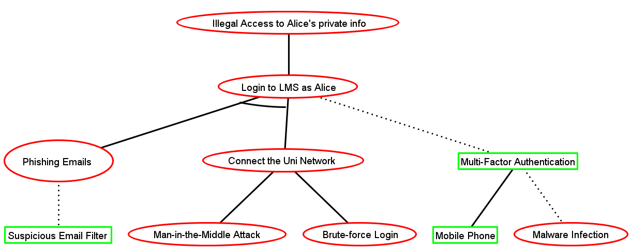
Part 1 Translate the attack-defense tree described below into code.
Example Question 6

Slide 49
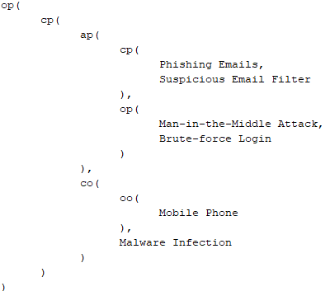
Part 1 Translate the attack-defense tree described below into code.
Example Question 6
Answer:

Slide 50
Part 2 In the attack-defense tree mentioned previously, each editable node has been assigned an initial success-probability value. Calculate the success probability value for each node marked with a question mark.
Example Question 6

Slide 51
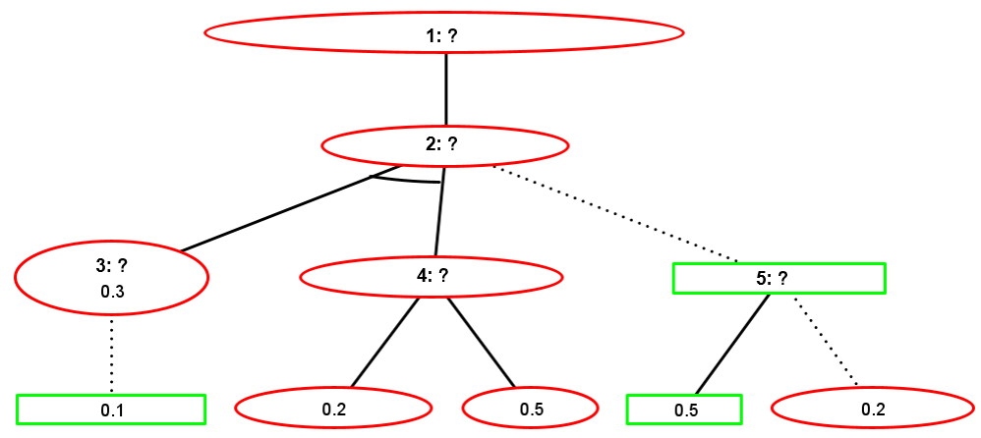
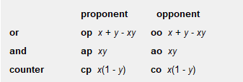
Example Question 6
Part 2
Answer: 1: 0.0972; 2: 0.0972; 3: 0.27; 4: 0.6; 5: 0.4

Slide 52
Example Question 7
Alice wants to send Bob a secret message. To keep the message confidential, she decides to use steganography.
Part 1 [5 marks] List 2 mediums that Alice can use for steganography. Explain 2 different steganography techniques that Alice can use, and provide an example for each technique to demonstrate how they work.
Part 2 [6 marks] Alice ultimately chooses to use text for steganography, but she is concerned that an attacker may use steganalysis methods to uncover her secret message. Compare 2 text steganography techniques including their respective advantages and limitations.
Part 3 [2 marks] Explain why MSB is not typically used for image steganography compared to LSB Part 4 [4 marks] Outline the steps of the digital forensics process and provide a brief explanation of key activities that take place during each step.

Slide 53
Example Question 7
Part 1 [5 marks] List 2 mediums that Alice can use for steganography. Explain 2 different steganography techniques that Alice can use, and provide an example for each technique to demonstrate how they work.

Slide 54
Example Question 7
Part 1 [5 marks] List 2 mediums that Alice can use for steganography. Explain 2 different steganography techniques that Alice can use, and provide an example for each technique to demonstrate how they work.
[0.5 mark] image
[0.5 mark] text [1 mark] LSB: the LSB of each pixel is replaced with a bit of the secret message to be hidden.
[1 mark] For example, if a binary representation of a pixel is 01010100, the LSB of the pixel is 0. If we want to hide the message "101", we can replace the LSB with the first bit of the message, resulting in the binary representation of the pixel becoming 01010101.
[1 mark] White space. In this method, a secret message is embedded into the blank spaces or unused areas of the image.
[1 mark] For example, given an image with a white border around it, the size of the white border can be increased or decreased in a particular pattern to encode a message. The changes are subtle and not visible to the human eye.

Slide 55
Example Question 7
Part 2 [6 marks] Alice ultimately chooses to employ text steganography, but she is concerned that an attacker may use steganalysis methods to uncover her secret message. Compare 2 text steganography techniques including their respective advantages and limitations.

Slide 56
Example Question 7
Part 2 [6 marks] Alice ultimately chooses to employ text steganography, but she is concerned that an attacker may use steganalysis methods to uncover her secret message. Compare 2 text steganography techniques including their respective advantages and limitations.
[1 mark] For position with key, we don’t add our secret message into the original text. Instead, we use a key to specify the positions of secret letters in the original text.
[1 mark] The key has a large space and it’s hard to brute-force the key.
[1 mark] However, it requires a secure communication channel to exchange the key with the receiver.
[1 mark] For white space, it uses blank spaces or unused areas within text to conceal secret information
[1 mark] it requires adding some blank spaces when necessary and most people, in their plain sight, do not notice the presence of extra spaces in a text.
[1 mark] white space can change the file size and this will make it easy to be detected.

Slide 57
Example Question 7
Part 3 [2 marks] Explain why MSB is not typically used for image steganography compared to LSB.

Slide 58
Example Question 7
Part 3 [2 marks] Explain why MSB is not typically used for image steganography compared to LSB.
[1 mark] MSB is to replace the most significant bit of a pixel with a bit of the secret message.
[1 mark] Compared to LSB, MSB altering the most significant bit can cause noticeable changes in the image, making itself easier to be detected by human eyes.

Slide 59
Example Question 7
Part 4 [4 marks] Outline the steps of the digital forensics process and provide a brief explanation of key activities that take place during each step.

Slide 60
Example Question 7
Part 4 [4 marks] Outline the steps of the digital forensics process and provide a brief explanation of key activities that take place during each step.
[1 mark] Collection:
Gather digital evidence using proper tools and techniques while maintaining a clear chain of custody; Identify sources of data; Secure devices to avoid tampering; Perform necessary decryption of data
[1 mark] Examination:
Search for evidence in the collected data. Use existing tools to assist in examination of data of recovering files of interest from memory
[1 mark] Analysis:
Examine collected digital evidence to identify relevant information, reconstruct events, and uncover hidden data; More in-depth exploration of materials; Attribution, establishing alibis, collecting statements, intents, all happen in this phase; Need to be based off of discovered, potential evidence; Basic description of image analysis, memory analysis.
[1 mark] Reporting:
Findings are documented; Create final reports to be used in legal proceedings

Slide 61
Example Question 8
Alice and Bob want to communicate securely via the internet. For instance, Alice wants to send a message to Bob with the message being encrypted. They have never met in person, nor have they communicated via the internet before.
Part 1 [6 marks] Describe the concept of public key infrastructure (PKI) and provide a step-by-step explanation of how PKI can be used to enable secure communication between two parties.
Part 2 [4 marks] Following on from Part 1, suppose a malicious third-party, Eve, is attempting to intercept and read the messages exchanged between Alice and Bob. What a possible attack could Eve carry out to compromise the security of their communication?

Slide 62
Example Question 8
Part 1 [6 marks] Describe the concept of public key infrastructure (PKI) and provide a step-by-step explanation of how PKI can be used to enable secure communication between the two parties.

Slide 63
Example Question 8
Part 1 [6 marks] Describe the concept of public key infrastructure (PKI) and provide a step-by-step explanation of how PKI can be used to enable secure communication between two parties.
[2 marks] Public key infrastructure is a cryptographic system that utilizes a pair of keys for encryption and decryption: a public key and a private key. The public key is freely shared, while the private key remains confidential.

Slide 64
Example Question 8
Part 1 [6 marks] Describe the concept of public key infrastructure (PKI) and provide a step-by-step explanation of how PKI can be used to enable secure communication between two parties.
[4 marks]
1. Alice and Bob generate their own public and private key pairs.
2. Alice and Bob exchange their public keys while keeping their private keys secret.
3. To send a secure message to Bob, Alice encrypts the message using Bob's public key.
4. When receiving the message, Bob uses his private key for decryption. For Bob, he encrypts his message using Alice's public key, and Alice decrypts it with her private key.

Slide 65
Example Question 8
Part 2 [4 marks] Following on from Part 1, suppose a malicious third-party, Eve, is attempting to intercept and read the messages exchanged between Alice and Bob. What a possible attack could Eve carry out to compromise the security of their communication?

Slide 66
Example Question 8
Part 2 [4 marks] Following on from Part 1, suppose a malicious third-party, Eve, is attempting to intercept and read the messages exchanged between Alice and Bob. What a possible attack could Eve carry out to compromise the security of their communication?
[1 mark] Eve generates two pairs of privates and public keys.
[1 mark] Eve intercepts the public key exchange between Alice and Bob,
[1 mark] Eve substitutes her own public keys for Alice's and Bob’s.
[1 mark] As a result, when Alice and Bob send encrypted messages to each other, they are actually encrypted with Eve's public keys, allowing her to decrypt the messages with her private keys.

Slide 67
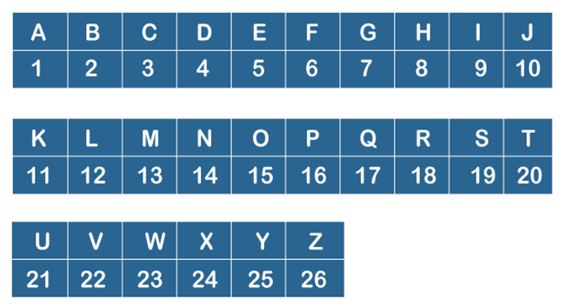
Example Question 9
Part 1 [5 marks] You invent the “FRNZ” cryptographic algorithm, which works on English messages, and all letters are treated as upper cases. FRNZ is implemented by the following steps:
Step 1. A Caesar cipher operates over the plaintext by the rotation number R (a positive R value means a forward rotation by R).
Step 2. The result in step 1 is converted, letter by letter, using the Alphanumeric table found below. For each output character, if it is even, its resulting character is 0 (i.e., even numbers are mapped to 0). If the output character is odd, its resulting character is 1 (i.e., odd numbers are mapped to 1).
Step 3. The result in step 2 is now XOR’d with the key K. If the length of the key is less than the length of the message, the key is padded (on the right) to the length of the message. For example, if the message has length 10, and K=1110, the padded key is 1110111011.
For example, the plaintext “HELLOWORLD”, with the values R=2, K=1110 produces the final result “1010000011”:
“HELLOWORLD” -> “JGNNQYQTNF”
“JGNNQYQTNF” -> “107141417251720146”
“107141417251720146” -> “0100111000”
“0100111000”
“1110111011.” -> “1010000011”

Slide 68
Example Question 9
Part 1 Your Task for this part:
Perform the FRNZ cryptographic algorithm, step by step, using the first 10 characters of your combined first and last names without spaces, e.g., “JOHNNY SMITH” becomes “JOHNNYSMIT”. Also, if your first or last name contains characters that cannot be found in the Alphanumeric table below, these characters will be skipped, e.g., “JOÚHNNY SMIÊTH” becomes “JOHNNYSMIT”.
If your first and last names combined without spaces are less than 10 characters long, pad the end of the combined string with the first characters from the string “LOREMIPSUM” until the final string is 10 characters long. For example, “JOHN DOE” becomes “JOHNDOE”. Then, as this is 7-characters long, pad it with the first 3 characters “LOR”. Thus, the final string becomes, “JOHNDOELOR”.
Use the values R=4, K=1010 in your answer.
[1 mark] successful rotation of R.
“HELLOWORLD” -> “LIPPSASVPH”
[2 marks] successful binary string conversion
“LIPPSASVPH” -> “12916161911922168”
“12916161911922168” -> “0100111000”

Slide 69
Example Question 9
Part 1 Your Task for this part:
Perform the FRNZ cryptographic algorithm, step by step, using the first 10 characters of your combined first and last names without spaces, e.g., “JOHNNY SMITH” becomes “JOHNNYSMIT”. Also, if your first or last name contains characters that cannot be found in the Alphanumeric table below, these characters will be skipped, e.g., “JOÚHNNY SMIÊTH” becomes “JOHNNYSMIT”.
If your first and last names combined without spaces are less than 10 characters long, pad the end of the combined string with the first characters from the string “LOREMIPSUM” until the final string is 10 characters long. For example, “JOHN DOE” becomes “JOHNDOE”. Then, as this is 7-characters long, pad it with the first 3 characters “LOR”. Thus, the final string becomes, “JOHNDOELOR”.
Use the values R=4, K=1010 in your answer.
[1 mark] correctly padding the key. “1010” -> “1010101010”
[1 mark] successful XOR
“0100111000”
“1010101010.” -> “1010000011”

Slide 70
Example Question 9
Part 2 [7 marks] Explain the factors that determine the security strength of the FRNZ cryptographic algorithm. What is the impact of changing the values of R and K on the security strength?

Slide 71
Example Question 9
Part 2 [7 marks] Explain the factors that determine the security strength of the FRNZ cryptographic algorithm. What is the impact of changing the values of R and K on the security strength?
.
[2 marks] FRNZ primarily relies on K and the mapping between numbers and bit 0/1.
[2 marks] the length of K determines the number of possible combinations for brute force, affecting the overall security. A longer K increases the number of combinations. For example, when K has 4 bits, it has 2^4 options. When K has 10 bits, it has 2^10 options.
[2 marks] one to many mapping of bit 0/1 to letter contributes to security. The actual complexity is 13^10.
[1 mark] either decreasing or increasing R has some marginally effect on overall security: only 26 rotations

Slide 72
Good Luck in all your final exams!!!
Exam Strategy: Prioritizing questions based on difficulty can help manage your time effectively and ensure you tackle the ones you're most confident about first.

